Slide 1
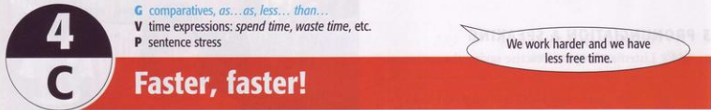
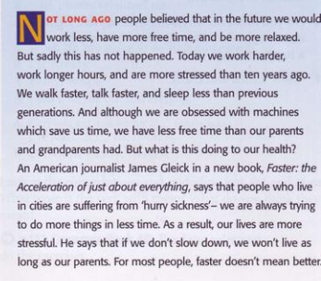
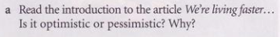
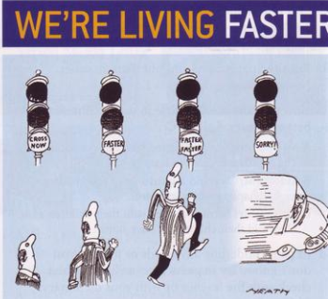
The article is pessimistic. Living faster does nor mean living better.
(The car hits him/runs him over)

Slide 2
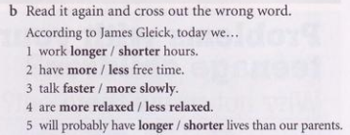
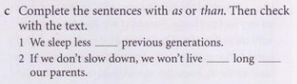
than
as
as

Slide 3
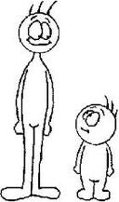


Comparative adjectives
Examples:
He is taller than me.
My car is cheaper than your car.

Slide 4




Chocolate is more delicious than lemons.
A snake is more dangerous than an earthworm.

Slide 5
We use Comparative adjectives to compare two people,things, etc.
USES:
Short adjectives
cold
hot
cheap
slow
fast
heavy
colder
hotter
cheaper
slower
faster
heavier
+ “er”

Slide 6
Long adjectives
interesting
intelligent
dangerous
expensive
beautiful
more interesting
more intelligent
more dangerous
more expensive
more beautiful
+ “more”
Ex: A car is more expensive than a bike.
Maria is more beautiful than Jennifer.

Slide 7
If a short adjective ends in one vowel + consonant (a,e,i,o,u) (b,c,d,f,g,h,j,k,l,m...) we double the consanant and add -er (except adjs ending “w”)
NOTES:
If a short adjective ends in e, we add -r
wide - wider large - larger
big - bigger
hot - hotter
thin - thinner
fat - fatter
new - newer
slow - slower
low - lower

Slide 8
If an adjective (one or two sylabbles) ends with a consonant + y, we change y to -i and add -er.
shy - shier
dry - drier
ugly - uglier
happy - happier
funny - funnier
easy - easier
If a short adjective ends with a vowel + y, we add -er.
grey - greyer
gay - gayer

Slide 9
Irregular words change;
good = better
bad = worse /wɜ:s/
many/much = more
little = less
far = farther/further(tg+kc)
old = older/elder(cấp bậc)

Slide 10
IMPORTANT NOTE:
With some 2-syllable adjectives end in “le, er, ow, et”, we can use "-er" OR "more":
quiet → quieter/more quiet clever → cleverer/more clever narrow → narrower/more narrow simple → simpler/more simple

Slide 11
FORMS:
Short Adjs:
S + tobe + shot adj + er + than + Noun/Pronoun
Ex: My brother is taller than you.
Bikes are slower than cars.
Long Adjs:
S + tobe + more + long adj + than + Noun/Pronoun
Ex: Lara is more beautiful than her older sister
He is more intelligent than me (I am)

Slide 12

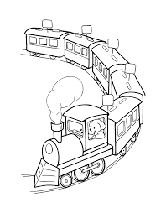
Comparative adverbs
Examples:
Planes go faster than trains
He drives more slowly than me.

Slide 13
We use Comparative advebs to compare two actions.
USES:
Short adverbs
fast
hard
high
low
late
wide
faster
harder
higher
lower
later
wider
+ “er”

Slide 14
Long adverbs
carefully
happily
quikly
slowly
sadly
more carefully
more happily
more quikly
more slowly
more sadly
+ “more”
Ex: A bike goes more slowly than a car
I drive more carefully than my brother.

Slide 15
Irregular words change;
well= better
many/much = more
little = less
far = farther/further(tg+kc)

Slide 16
FORMS:
Short Advs:
S + V + shot adv + er + than + N/Pronoun
Ex: My brother plays football better than I do.
Long Adjs:
S + V + more + long adv + than + N/Pronoun
Ex: Lara sings more beautiful than her older sister
Note: after than + Subject pronouns NOT Object

Slide 17
Equative Comparision
Examples:
My house is as high as her. Or
My house is the same height as her.
The sushi is as delicious as the fish.
Britney sings as beautifully as Taylor.
Tom has as many books as Jane.
USES:
We use Equative Comparison to compare things, events, and people in an equal state.

Slide 18
FORMS:
With adjectives/ adverbs
( +) S + V + as + adj/ adv + as + N/ pronoun
S + V + the same + (noun) + as + N/ pronoun
Ex: Lan is as young as Hoa
He sings the same song as his.
( - ) S + V + not as/so + adj/ adv + as + N/ pronoun
Ex: Lan isn’t as/so beautiful as Hoa

Slide 19
With countable nouns:
S + V + as many + plural noun + as + N/ pronoun/ Clause
Ex: My brother has as many toys as me.
With uncountable nouns:
S + V + as much + uncountable noun + as + N/ pronoun/ Clause
Ex: I have as much money as my brother.

Slide 20
Less Comparision
We use Less Comparision to express the inferiority between two people, things…
FORMS:
With adjectives/ adverbs
S + V + less + adj/adv + than + N/pronoun = S + V + not as + adj/adv + as + N/pronoun
Ex: This book is less interesting than that book.
= This book is not as interesting as that book.

Slide 21
With countable nouns:
S + V + fewer+ plural noun + than + N/ Pro
Ex: I bought fewer cakes than my sister
With uncountable nouns:
S + V + less+ uncountable noun + than + N/ Pro/ Clause
Ex: I have less spare time than Hoa

Slide 22
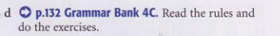
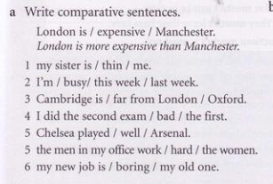
1 My sister is thinner than me.
2 I’m busier this week than I was last week.
3 Cambridge is further from London than Oxford.
4 I did the second exam more badly than the first.
5 Chelsea played better than Arsenal.
6 The men in my office work harder than the women.
7 My new job is more boring than my old one.

Slide 23
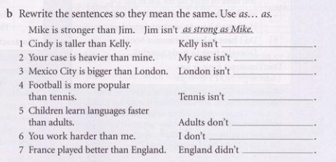
as tall as Cindy
as heavy as yours
as big as Mexico city
as popular as football
learn languages as fast as children
work as hard as you
play as well as France

Slide 24

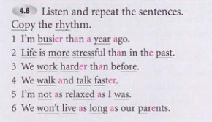


Slide 25

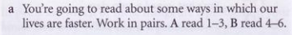

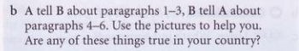
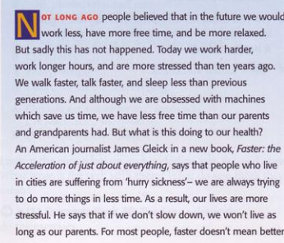
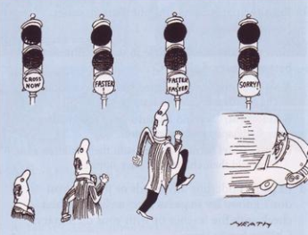

Slide 26
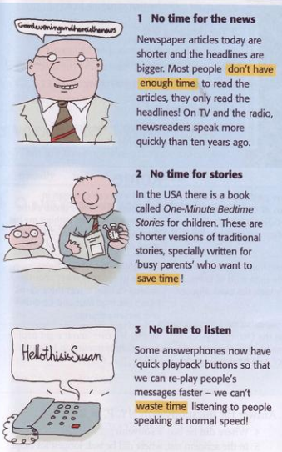
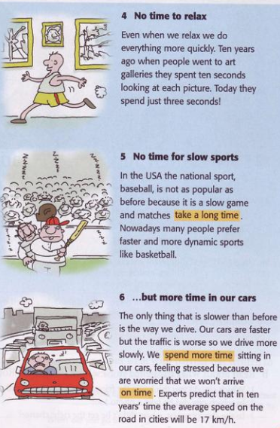
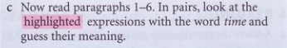
Don’t have enough time - don’t have the time you need
Save time - do something more quickly so that you have more time
Waste time - use time badly
Take a long time - last too long
Spend more time - use more time
On time - punctual, not lste

Slide 27

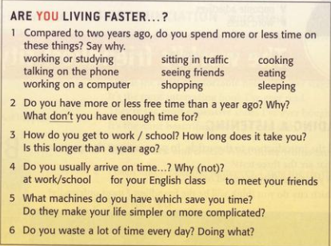
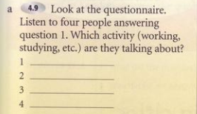
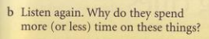
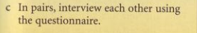
talking on the phone
cooking
sleeping
sitting in traffic
1 They spend more time on talking on the phone
because their daughter phone them every day.
2 They spend a lot less time on cooking because they have just come back to work.
3 They spend less time on sleeping because They have too much homework.
4 They spend more time on sitting in traffic because They spend more time on sitting in traffic.

Slide 28
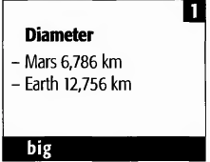
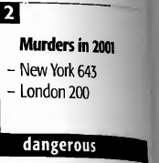
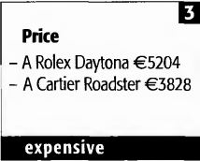
Exercises:
1. Earth is bigger than Mars.
2. NewYork is more dangerous than London.
3. A Rolex Daytona is more expensive than A Cartier Roadster.

Slide 29
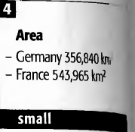
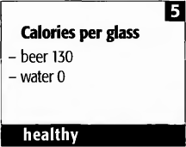
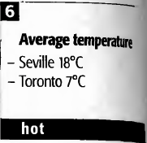
4. Germany is smaller than France.
5. Water is healthier than beer.
6. Seville is hotter than Toronto

Slide 30
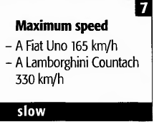
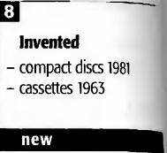
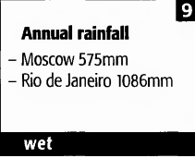
7. A Fiat Uno is slower than a Lamborghini.
8. Compact discs is newer than cassettes.
9. Rio de Janeiro is wetter than Moscow.

Slide 31
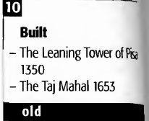
10. The Leaning Tower of pica is older than the Taj Mahal.

